Slide 1
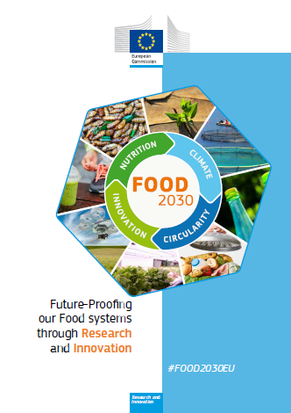
Research & Innovation
for tomorrow's
nutrition and food systems
Barend VERACHTERT
Head of Unit
F3 - Agri-Food Chain
DG Research & Innovation
European Commission, Brussels

Slide 2
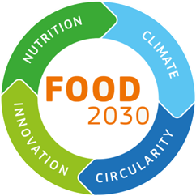
Table of Contents
FNS - Framing problems & opportunities
The challenges for European agriculture
FOOD 2030 – what is it?
Horizon 2020 – an implementation tool
Working with others
FOOD 2030 - Next steps

Slide 3
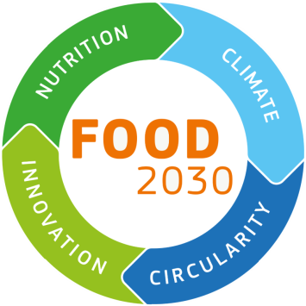
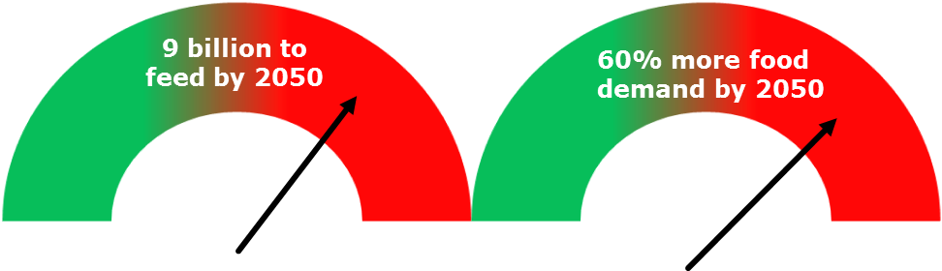
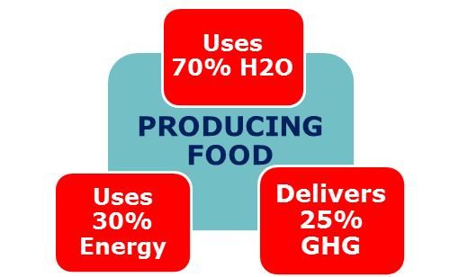
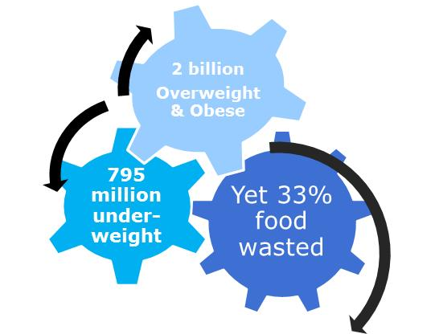
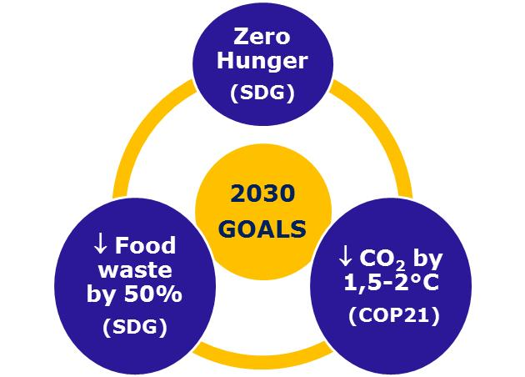
A "Perfect Storm"

Slide 4
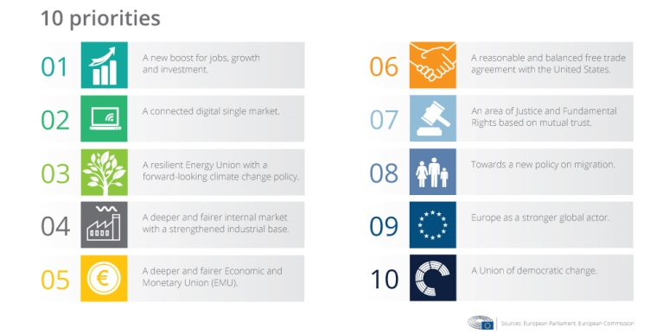
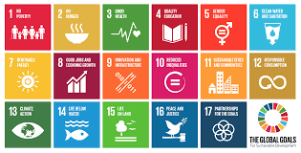


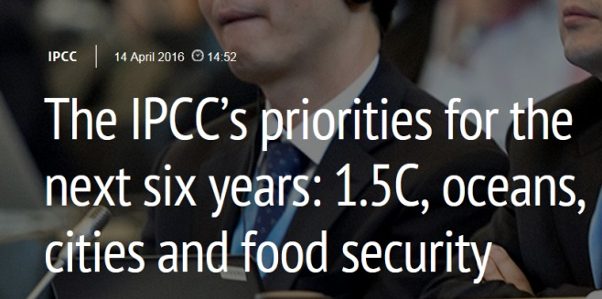
Political Opportunity
Juncker Priorities & Modern CAP
Sustainable Development Goals
COP21+
World Food Day 2017
IPCC

Slide 5
Table of Contents
FNS - Framing problems & opportunities
The challenges for European agriculture
FOOD 2030 – what is it?
Horizon 2020 – an implementation tool
Working with others
FOOD 2030 - Next steps

Slide 6
Challenges for European agriculture
Agri-production become more vulnerable:
globalisation of the markets, competition
prices volatility, economic uncertainty
low incremental crop productivity
Additional stress created by:
increasing demand for food and feed
increasing environmental concerns
uncertainty generated by climatic changes

Slide 7
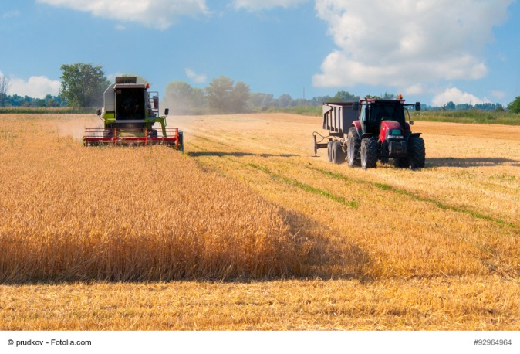
Sustainable farming means…
…more efficient agricultural production systems with less impact on the environment:
More efficient use of water, soil and biodiversity resources
More efficient use of nutrients (for plants), and feed (for animals)
Reduction of GHGs (mitigation approach)
Resilience to climate change (adaptation approach)

Slide 8
A food-system approach is needed
Moving from business-as-usual agriculture to Sustainable farming is a complex process which requires a system approach
Reshape the role of the farmer: from mere producer of food and commodities, into "wise manager of the natural capital"
This transition must be backed by effective policies (CAP) supported with dedicated Research & Innovation programmes

Slide 9
Table of Contents
FNS - Framing problems & opportunities
The challenges for European agriculture
FOOD 2030 – what is it?
Horizon 2020 – an implementation tool
Working with others
FOOD 2030 - Next steps

Slide 10

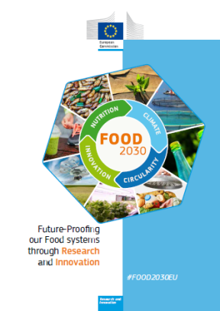
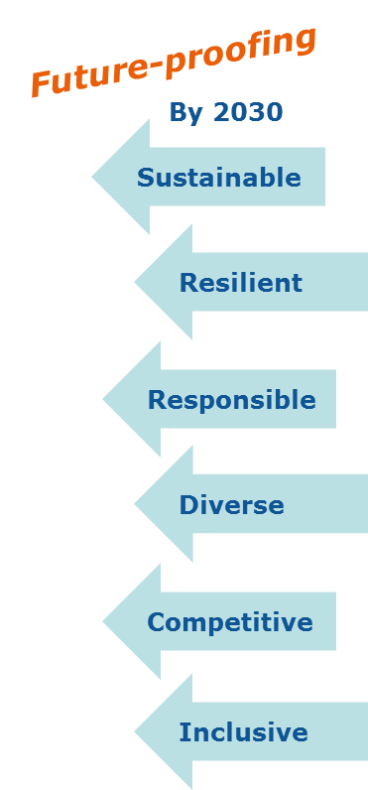
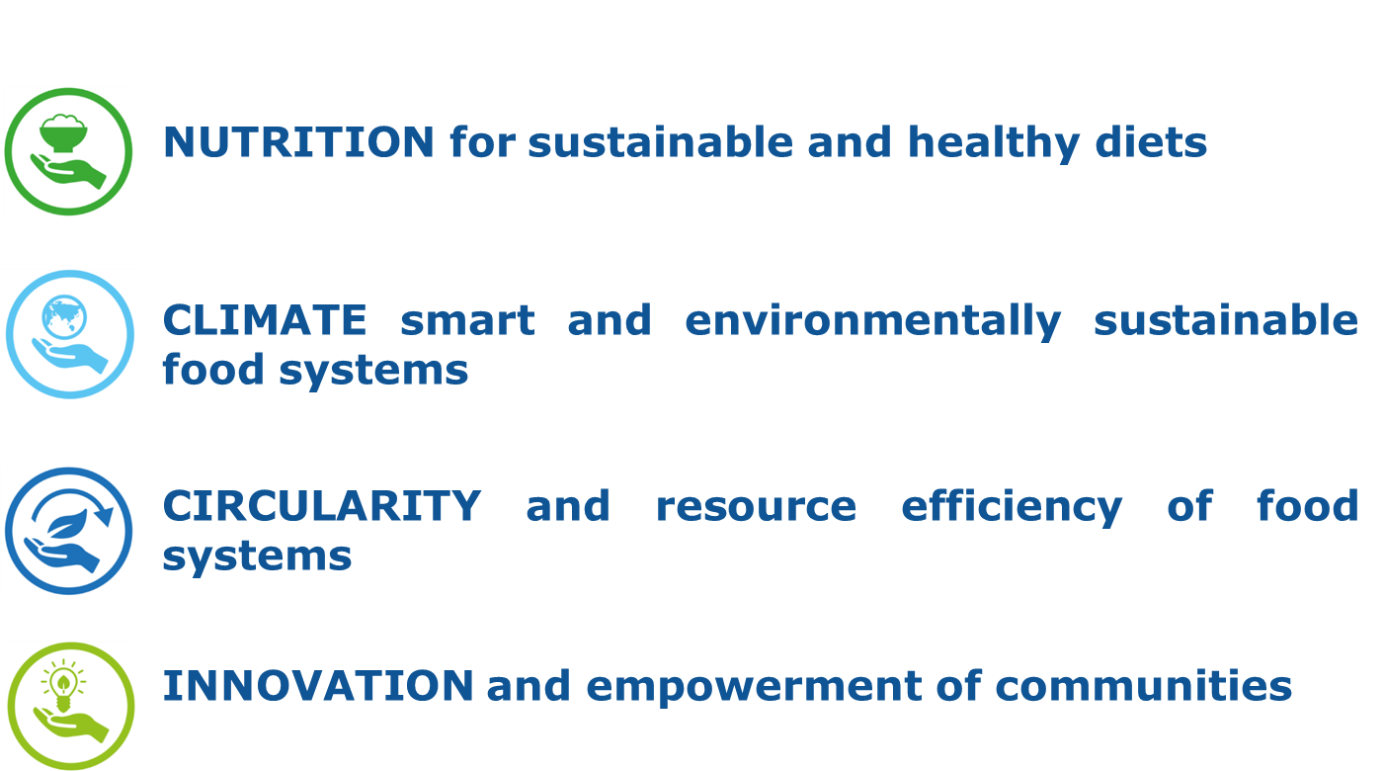
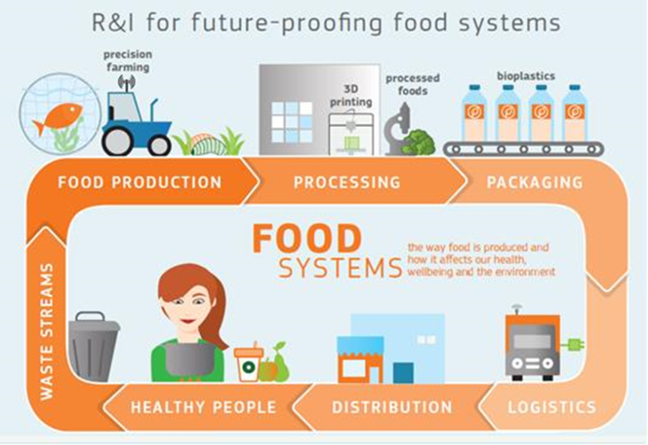
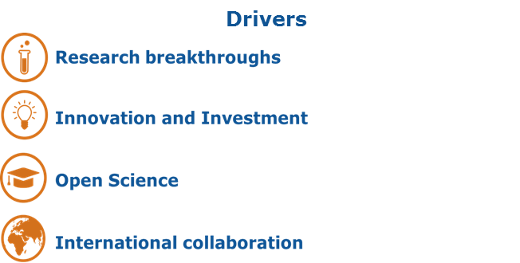

FOOD 2030
EU R&I Policy Framework to future-proof our nutrition & food systems
Priorities
Need for a systemic approach to future-proofing food systems by structuring, connecting and scaling-up R&I
To provide evidence for policies and solutions (knowledge, methods, technologies, services, business models, etc) addressing 4 priorities.

Slide 11
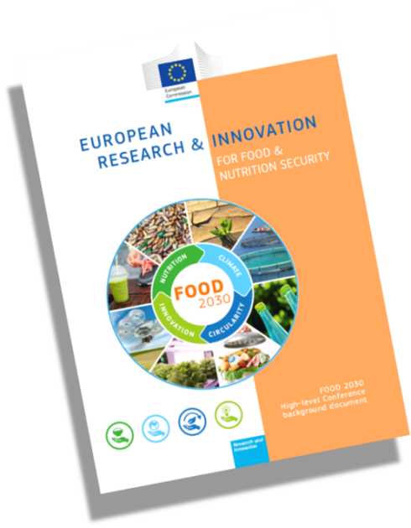

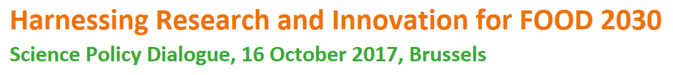
Milestones so far

Slide 12
Table of Contents
FNS - Framing problems & opportunities
The challenges for European agriculture
FOOD 2030 – what is it?
Horizon 2020 – an implementation tool
Working with others
FOOD 2030 - Next steps

Slide 13
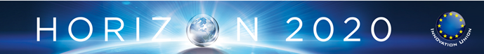
The EU Framework Programme for R&I
Excellent science
Industrial leadership
Societal Challenges
1. Health, demographic change and wellbeing
2. Food security, sustainable agriculture and forestry, marine & maritime and inland water research, and the bioeconomy
3. Secure, clean and efficient energy
4. Smart, green and integrated transport
5. Climate action, resource efficiency and raw materials
6. Inclusive, innovative and reflective societies
7. Secure societies
2014 | 2015 | 2016 | 2017 | 2018 | 2019 |  | 2020
Strategic Programme
Work Programme 1 |  | Strategic Programme
 |  | Work Programme 2 |  | Strategic Programme
 |  |  |  | WP 3 (18-19) |  | WP 4 (2020)
€ 482 M |  | € 756 M |  | € 1500 M
FOOD 2030 CSA
FOOD 2030 Expert Group
More to come!

Slide 14
Draft SC2 WP 2018-2020 now available online
https://ec.europa.eu/programmes/horizon2020/en/food-security-sustainable-agriculture-and-forestry-marine-maritime-and-inland-water-research-and-0
With several topics addressing Sustainable farming, the Food chain and the Rural areas

Slide 15
Table of Contents
FNS - Framing problems & opportunities
The challenges for European agriculture
FOOD 2030 – what is it?
Horizon 2020 – an implementation tool
Working with others
FOOD 2030 - Next steps

Slide 16
Working with MS and users
Standing Committee for Agricultural Research (SCAR)
SWG Food Systems – national mapping of R&I investments (themes & expenditures, who does what, link to policies)
  Joint Programming Initiatives
  Collaboration HDHL, FACCE, OCEANS
  EIP AGRI
  The one-stop-shop for Agricultural Innovation in Europe
  Support Bioeast to develop common Vision Paper/SRIA

Slide 17

Working with Regions
Smart Specialisation Platform - "S3P Agri-Food"
To accelerate the development of joint investment projects in the EU
To encourage and support interregional cooperation
Ex-ante condition for regions to access ESIF funding
Contribute to a more competitive and sustainable EU food supply chain and more resilient food systems
Eastern EU countries encouraged to get involved
http://s3platform.jrc.ec.europa.eu/agri-food

Slide 18
Working with private sector
European & National Technology Platforms
stakeholder fora (academia, research & industry)
R&I agendas, & roadmaps at EU/ national level
mobilise stakeholders on agreed priorities
ETP 'Food for Life', 'FABRE', 'Plants For The Future', …
Knowledge & Innovation Communities (KICs)
  public-private partnerships
  addressing innovation – education – business creation
  EIT Food, EIT Health, EIT Climate, EIT Digital, …

Slide 19
Table of Contents
FNS - Framing problems & opportunities
The challenges for European agriculture
FOOD 2030 – what is it?
Horizon 2020 – an implementation tool
Working with others
FOOD 2030 - Next steps

Slide 20
FOOD 2030 Next Steps
2nd FOOD 2030
High Level Event
21-22 June 2018
Plovdiv, BG
MS Mapping of Food Systems R&I
Dec 2017
Launch FOOD 2030 CSA
Nov 2017 to end 2020
FOOD 2030 World Food Day Conf.
16 Oct 2017, Brussels
Launch FOOD 2030 Expert Group
Sept. 2017 to March 2018

Slide 21
FOOD 2030 - NEW LEVEL
OF AMBITION, IMPACT AND FOCUS
Food system approach
New partnerships with Member States, business, society and other stakeholders
Map & close R&I investment gap
Connect R&I, from 'farm-to-fork-to-gut-and back' including primary production
Game changing technologies, approaches, business models
New global platform

Slide 22

Thank you!
Email: barend.verachtert@ec.europa.eu
Website bioeconomy directorate: http://ec.europa.eu/research/bioeconomy
Twitter: #FOOD2030EU

