Slide 1
The new CAP-making EU farming smart and sustainable
^{Budapest, 18 October 2017}
DG Agriculture and Rural Development
European Commission
Flavio COTURNI
Head of Unit – Policy Perspectives
^{#FutureofCAP}

Slide 2
Outline
Why do we need a new CAP?
Sectorial challenges (agriculture)
Cross-cutting challenges
The priorities of intervention
The process ahead

Slide 3
Decreasing trend in real income in EU-28
Source: DG Agriculture and Rural development, based on Eurostat Economic Accounts for Agriculture and EU Agricultural Outlook
3

Slide 4
Average wage vs. agricultural income per hour
Source: based on CAP context indicator - C26

Slide 5
Farm Income volatility share of farms with losses >30% compared to average of 3 previous years
Source: DG Agriculture and Rural Development, based on FADN data
5

Slide 6
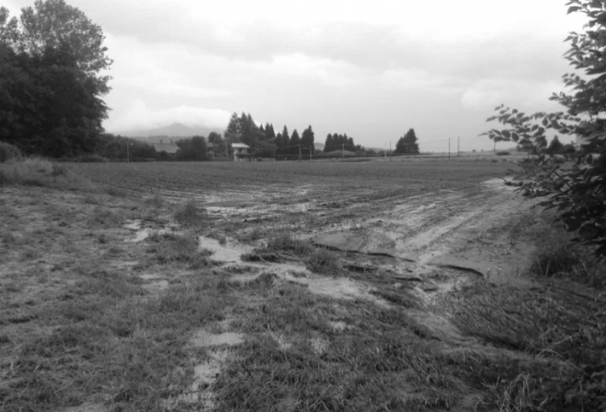
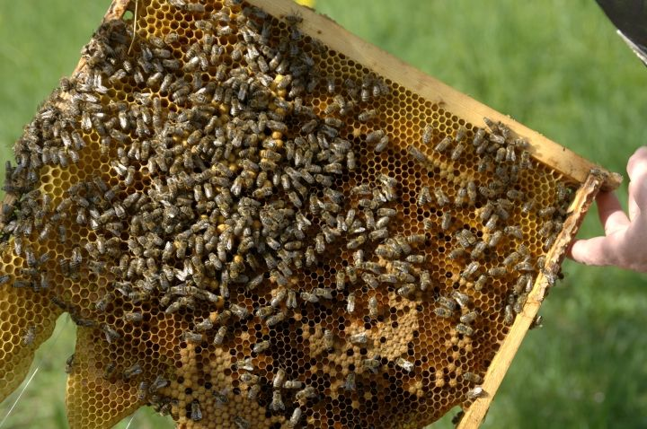
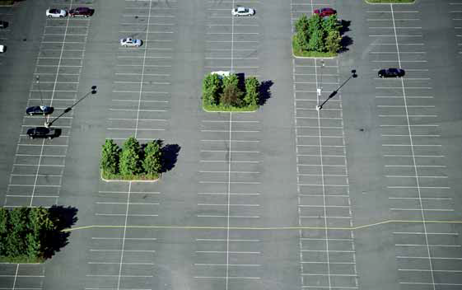
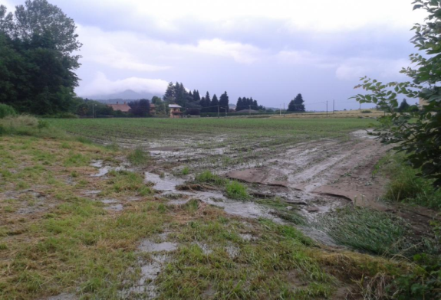
Pressure on natural resources

Slide 7
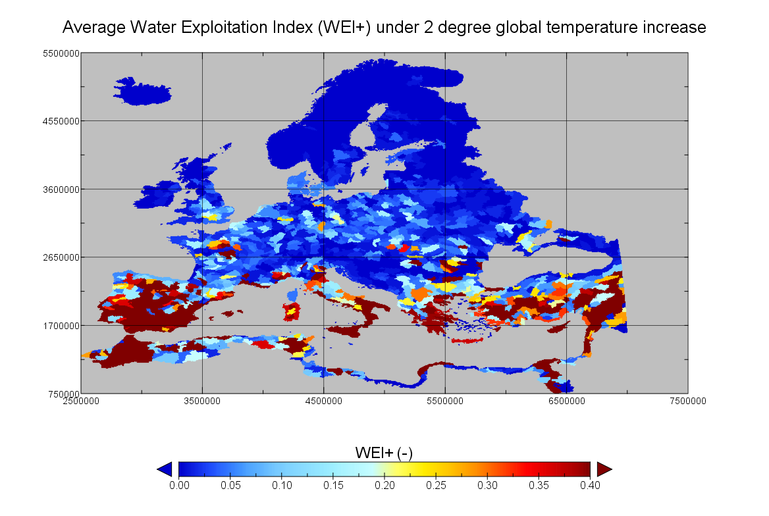
Lower water availability due to climate change in 2050
Source: JRC, 2017 - Ref year: 2050
7

Slide 8
Labour outflows from farming
Source: Eurostat
8

Slide 9
Youth unemployment (15-24 years old) in EU-28 by type of region, 2009-2015
Source: Eurostat
9

Slide 10
Next-generation broadband coverage in EU, 2010-15
10

Slide 11
Poverty rate by type of region in EU-28, 2014
Source: Eurostat
11

Slide 12
Cross-cutting challenges
Contribution to EU priorities and SDGs, Policy Coherence
Subsidiarity / EU added value
Simplification
Budget focused on results

Slide 13
Objectives for the future CAP
Economic
Foster a smart and resilient agricultural sector
Environmental
Enhance environmental sustainability and climate-resilience
Strengthen the socio-economic fabric of rural areas (including generational renewal)
Social
Cross-cutting
More subsidiarity More Knowledge
13

Slide 14
Income support, some questions
Distribution of direct payments: is it an issue?
Is more targeting needed? If yes, how?
External convergence ?
Co-financing ?
Cross-compliance and greening (in relation to AECMs)

Slide 15
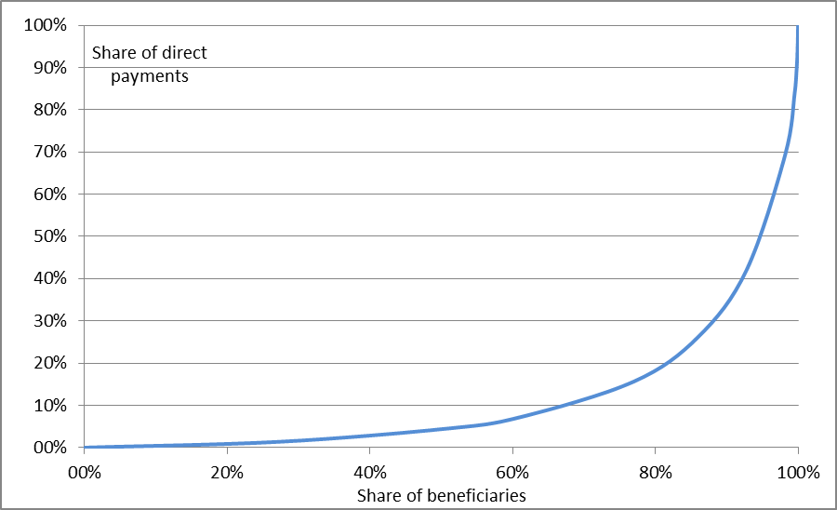
Distribution of direct payments- 2015

Slide 16
The process
Problem definition
Objectives
Policy options and assessment
Consultation
Impact assessment

Slide 17
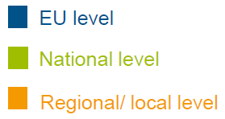
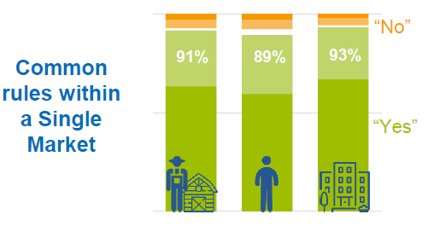
Public Consultation: Keeping a strong Agricultural Policy at EU level
Having a CAP makes sense because we need…
Which level of government?

Slide 18
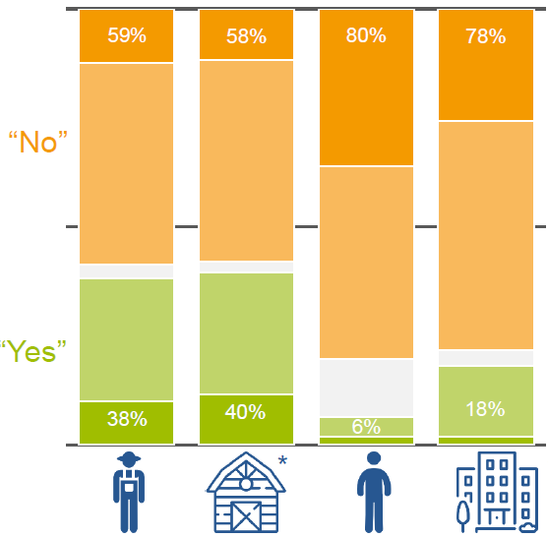
Public consultation: negative reply when assessing to what extent the CAP addresses the environmental challenges

Slide 19
Public consultation: Agreement on the call for a modern and simpler CAP

Slide 20
Context and timing of the process
2017
Commission Communication on the CAP
European summit
2018
Legal proposals on the Multiannual Financial Framework
Legal proposals for EU policies
2019
UK leaves the EU
End of mandate of the European Parliament and the European Commission
New European Parliament, new European Commission

Slide 21
Further information will be available at:
https://ec.europa.eu/agriculture/consultations/cap-modernising/2017_en
Thank you for your attention!
21

